Slide 1
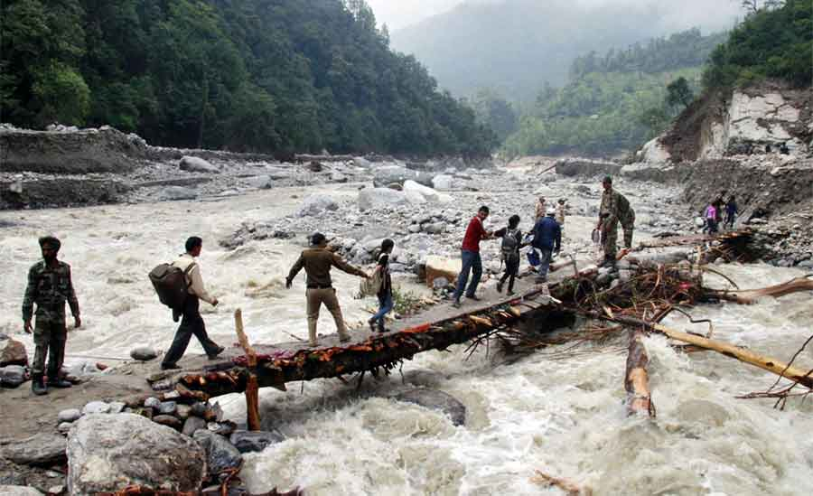
Seminar
On
Disaster Management
Submitted By: Group 2 Members:-
Ashish kr. Pathak 41221028
Karmvir 41221075
Ritik kumar 41221131
Sachin kr. Singh 41221138
Harsh kumar 41221057
Sachin rajbhar 41221139
Submitted To:
Dr. Devesh Kumar
Notes:
1
1

Slide 2
Content
What is disaster management ?
Why it is important?
Types of Disaster management
Disaster Mangement cycle
Background( Types, Characteristic, Phases of disaster )
Principles of disaster management
Phases of Disaster Mangement (Detailed)
Some facts & Nodal agencies in INDIA
Lessons Learnt
Future Directions
References

Slide 3
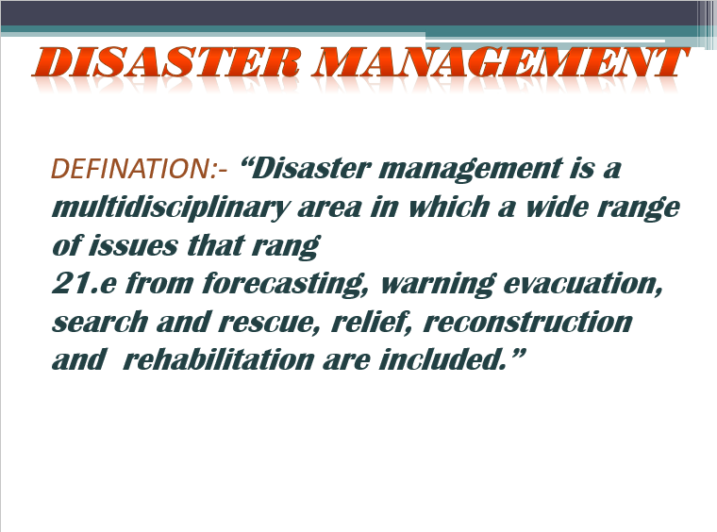
What is disaster management ???
“A disaster can be defined as any occurrence that cause damage, ecological disruption, loss of human life, deterioration of health and health services on a scale, sufficient to warrant an extraordinary response from outside the affected community or area”. (W.H.O.)
“A disaster can be defined as an occurrence either nature or manmade that causes human suffering and creates human needs that victims cannot alleviate without assistance”. American Red Cross (ARC) ’

Slide 4
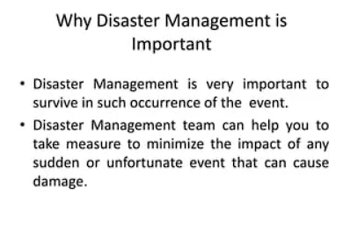

Slide 5
TYPES OF DISASTER MANAGEMENT-
1.Pre condition- evacuation
2.Post operation-rescue

Slide 6
Pre disaster-
Mitigation,
Preparedness, &
Emergency response activities.
During disaster-
Response,&
Recovery activities.
Post disaster-
Immidiate searching operation,
Provide food materials,
Medical facilities,
Rehabitation,
Migration,&
Reconstruction.
DISASTER MANAGEMENT CYCLE

Slide 7
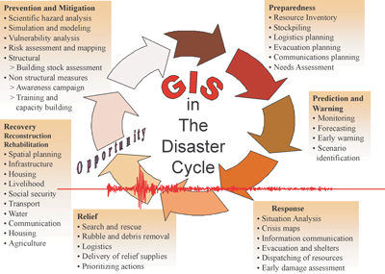

Slide 8
BACKGROUND
The reasons for this are varied including:
an increasing population pressures in urban areas
an increase in the extent of immigrants into lands, e.g., river beds or drainage courses, low lying areas etc.
poor or ignored zoning laws and policies
lack of proper risk management (insurance)
Notes:
The reasons for this are varied including:
an increasing population pressures in urban areas
an increase in the extent of encroachment into lands, e.g., river beds or drainage courses, low lying areas etc.
poor or ignored zoning laws and policies
lack of proper risk management (insurance)
In India the primary responsibility for responding to disasters lies at the State level.
Many states have yet to prepare Disaster Management Plans.
Section 11 of DM Act provides that “There shall be drawn up a plan for Disaster Management for the whole of the Country to be called National Plan.”
The National Response Plan to be prepared by an Inter Ministerial Central Team formed by the NEC in the MHA Spanning all the Central Ministries/Departments.
The Mitigation and Preparedness Plans
The National Human Resource and Capacity Building Plan To be prepared by National Institute of Disaster Management,

Slide 9
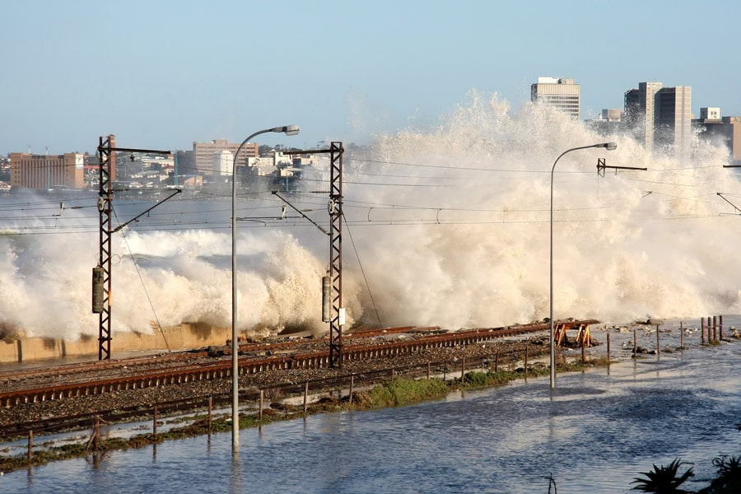
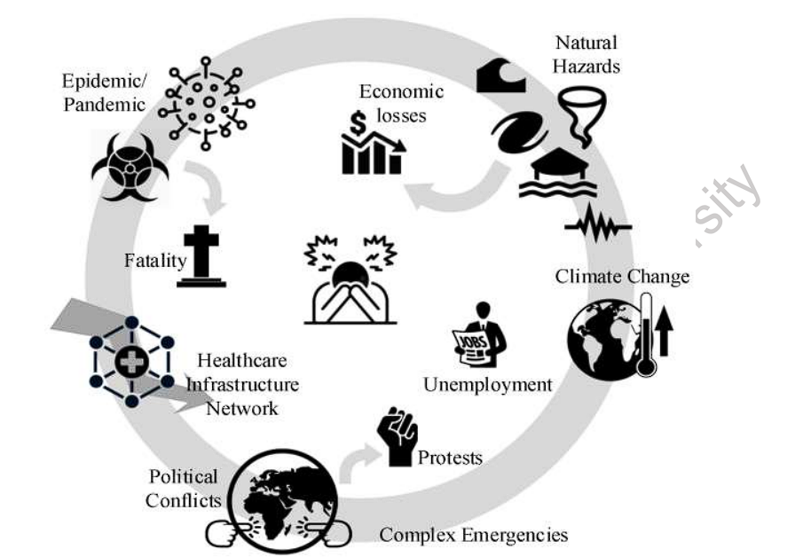

Slide 10
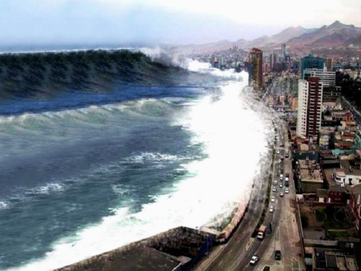
TYPES OF DISASTER
Natural Disasters
Meteorological
Random/physical weakness of structures and processes
Man-made Disasters
Technological
Like CYBERATTACKS
Industrial accidents
Environmental
Like FLOODS
Security related
Complex Emergencies
requires quick response
Ex: SYRRIA
Pandemic
Environmental
societal/institutional weakness
a wide geographic area
Ex: Malaria, SARS COVID 19
significant proportion of the population

Slide 11
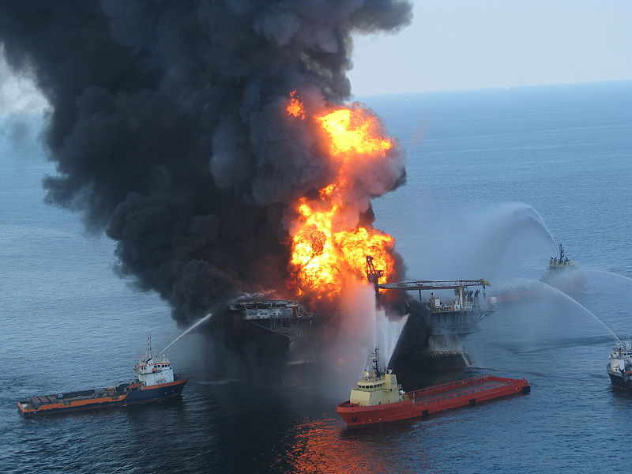
CHARACTERISTIC OF DISASTER
Predictability
Controllability
Speed of onset
Length of forewarning
Duration of impact
Scope and intensity of impact

Slide 12
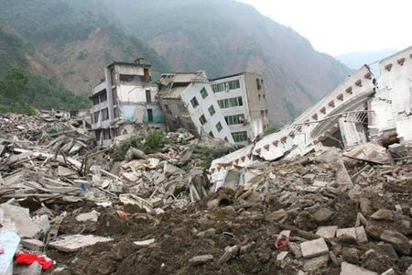
PHASES OF DISASTER
Pre-impact phase
Impact phase
Post-impact phase

Slide 13
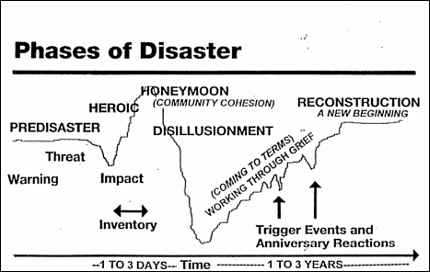

Slide 14
PRINCIPLES OF DISASTER MANAGEMENT
It is the responsibility of all spheres of government
Should use resources that exist for a day-to-day purpose.
Organizations should function as an extension of their core business
Individuals are responsible for their own safety.
Disaster management planning should focus on large-scale events.

Slide 15
PHASES OF DISASTER MANAGEMENT
Disaster Mitigation
Disaster Preparedness
Disaster Response
Disaster Recovery
Rehabilitation
Disaster effects
Disaster impact
Pre disaster-
During disaster-
Post disaster-

Slide 16
Disaster mitigation
This involves lessening the likely effects of emergencies.
These include depending upon the disaster, protection of vulnerable population and structure.
Eg. improving structural qualities of schools, houses and such other buildings so that medical causalities can be minimized.
Similarly ensuring the safety of health facilities and public health services including water supply and sewerage system to reduce the cost of rehabilitation and reconstruction.
This mitigation compliments the disaster preparedness and disaster response activities.

Slide 17
Disaster preparedness
Preparedness should be in the form of money, manpower and materials
Evaluation from past experiences about risk
Location of disaster prone areas
Organization of communication, information and warning system
Ensuring co-ordination and response mechanisms
Development of public education programme
Co-ordination with media
National & international relations
Keeping stock of foods, drug and other essential commodities.

Slide 18
E.g.: Indian Meteorological department (IMD) plays a key role in forewarning the disaster of cyclone-storms by detection tracing. It has 5 centres in Kolkata, Bhubaneswar, Vishakapatanam, Chennai & Mumbai. In addition there are 31 special observation posts setup a long the east coast of India.
The International Agencies which provides humanitarian assistance to the disaster strike areas are United Nation agencies.
Office for the co-ordination of Humanitarian Affair (OCHA)
World Health Organization (WHO)
UNICEF
World Food Programme (WFP)
Food & Agricultural Organisation (FAD)
E.g.: Non Governmental Organizations
Co-Operative American Relief Every where (CARE)
International committee of Red cross
International committee of Red cross

Slide 19
Disaster response
Epidemiologic surveillance and disease control
Vaccination
Nutrition

Slide 20
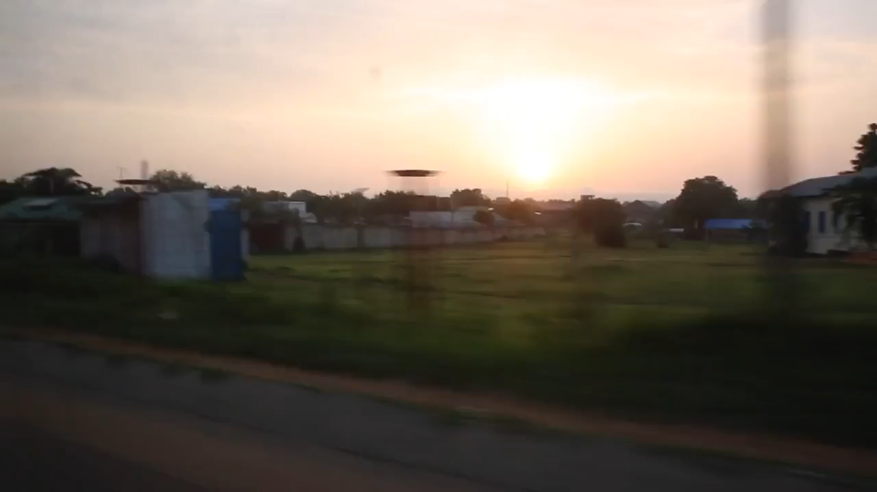
A 60 second video of a 7 day Rapid Response Mission to New Fangkak, Jonglei State in South Sudan. https://www.youtube.com/watch?v=awymGZLZjq4&ab_channel=UNICEFCareers Credit: UNICEF

Slide 21
DISASTER RECOVERY
Successful Recovery Preparation
Be vigilant in Health teaching
Psychological support
Referrals to hospital as needed
Remain alert for environmental health
Nurse must be attentive to the danger

Slide 22
Rehabilitation phase
Water supply
Food safety
Basic sanitation and personal hygiene
Vector control

Slide 23
DISASTER-EFFECTS
Deaths
Disability
Increase in communicable disease
Psychological problems
Food shortage
Socioeconomic losses
Shortage of drugs and medical supplies.
Environmental disruption

Slide 24
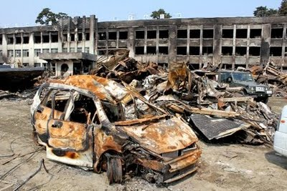
Disaster impact
Search, rescue and first aid
Field care
Triage
Tagging
Identification of dead

Slide 25
Major Disasters in India
1984 Bhopal Gas Tragedy
2001 Gujarat earthquake
2004 Indian Ocean tsunami
2008 Mumbai attacks

Slide 26
India’s Vulnerability to Disasters
57% land is vulnerable to earthquakes. Of these, 12% is vulnerable to severe earthquakes.
68% land is vulnerable to drought.
12% land is vulnerable to floods.
8% land is vulnerable to cyclones.
Apart from natural disasters, some cities in India are also vulnerable to chemical and industrial disasters and man-made disasters.

Slide 27
GOI – NGO Disaster preparation and Response Committee
Members
World Vision of India
SOS Children's Village India
Ramakrishna Mission
Plan international
OXFAM India Trust
Lutheran World Service India
Red Cross
Catholic Relief Services
CASA
CARITAS India
Voluntary Health association Of India
Action Aid
Action for Food Production-AFPRO
Indo German Social Services Society

Slide 28
Nodal Agencies for Disaster Management
Floods : Ministry of Water Resources, CWC
Cyclones : Indian Meteorological Department
Earthquakes : Indian Meteorological Department
Epidemics : Ministry of Health and Family Welfare
Avian Flu: Ministry of Health, Ministry of Environment,
Ministry of Agriculture and Animal Husbandry

Slide 29
Nodal Agencies for Disaster Management
Chemical Disasters : Ministry of Environment and Forests
Industrial Disasters : Ministry of Labour
Rail Accidents : Ministry of Railways
Air Accidents : Ministry of Civil Aviation
Fire : Ministry of Home Affairs
Nuclear Incidents : Department of Atomic Energy
Mine Disasters : Department of Mines

Slide 30
Lessons Learnt
Be Prepared : Preparedness and Mitigation is bound to yield more effective returns than distributing relief after a disaster.
Create a Culture of Preparedness and Prevention.
Evolve a code of conduct for all stake-holders

Slide 31
Future Directions
Encourage and consolidate knowledge networks
Mobilise and train disaster volunteers for more effective preparedness, mitigation and response (NSS, NCC, Scouts and Guides, NYK, Civil Defence, Homeguards)
Increased capacity building leads to faster vulnerability reduction.
Learn from best practices in disaster preparedness, mitigation and disaster response

Slide 32
Future Directions
Mobilising stakeholder participation of Self Help Groups, Women’s Groups, Youth Groups, Panchayati Raj Institutions
Anticipatory Governance: Simulation exercises, Mock drills and Scenario Analysis
Indigenous knowledge systems and coping practices
Living with Risk: Community Based Disaster Risk Management

Slide 33
Future Directions
Inclusive, participatory, gender sensitive, child friendly, eco-friendly and disabled friendly disaster management
Technology driven but people owned
Knowledge Management: Documentation and use of good practices
Public Private Partnership

Slide 34
REFERENCES
www.google.com
www.wikipedia.com
www.studymafia.org

Slide 35
Thanks

